Slide 1

Outline of today’s class
BES102 & BVW102
25 February 2009
Philip Button
Department of Agriculture and Animal Science
Northern Melbourne Institute of TAFE

Slide 2
Outline of today’s class
Lecture 1
  Introduction to the subject
  Administrative and housekeeping matters
Lecture 2
  Introduction to science and chemistry
  Fundamentals of chemistry
  Measurement, recording, reporting of results
Practical class 1
  Introduction to the chemistry laboratory and report writing

Slide 3
Introduction to the subject
Lecture 1 for BES102 & BVW102
25 February 2009
Philip Button
Department of Agriculture and Animal Science
Northern Melbourne Institute of TAFE

Slide 4
Lecture 1 objectives
Understand the relationship between 1st-year chemistry and other subjects in your course
Know
  How each class will run
  The prescribed textbook and chapters we’ll cover
  How you’ll be assessed
  How to reference and where to find the information
  What plagiarism is
  Appropriate class conduct
  Attendance requirements
  How to contact me

Slide 5
Welcome to chemistry!
BES102 (Chemical Concepts)
  Equine Studies
BVW102 (Introductory Chemistry)
  Viticulture and Winemaking
Introductory study of chemistry
Enough chemistry for you to study more advanced subjects in biology and chemistry
Chemistry that’s relevant to biology

Slide 6
BES102 and further study
BES102
  BES103 (Biology)
  BES106 (Equine Physiology)
  BES107 (Microbiology)
  BES203 (Equine Nutrition)
  BES303 (Equine Exercise Physiology)

Slide 7
BVW102 and further study
BVW102
  BVW103 (Soil Science and Plant Nutrition)
  BVW106 (Introduction to Entomology and Microbiology)
  BVW108 (Plant Physiolog)
  BVW203 (Wine Chemistry I)
  BVW306 (Wine Chemistry II)
  BVW308 (Wine Microbiology and Biotechnology)

Slide 8
Daily schedule
  All classes held in L109
  2 hour lecture
  3 hour practical
  Timetable states 10:00-16:00
    Lecture from 10:00-12:00
    Practical from 13:00-16:00
    Willing to vary times
      Earlier start
      Shorter lunch
      Maybe finish at 15:00?
  bfhfb

Slide 9
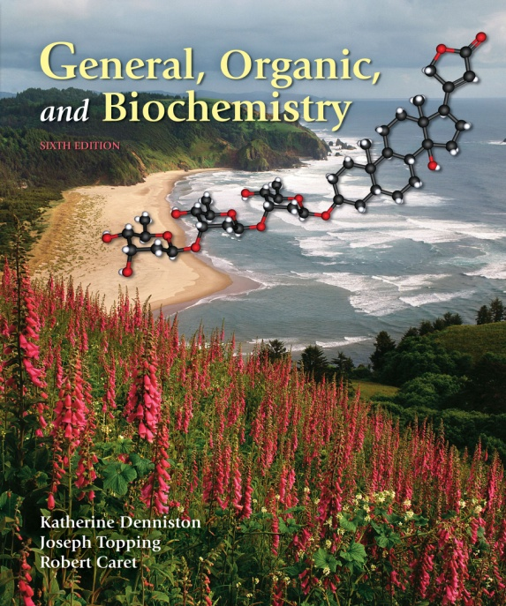

Prescribed textbook
Denniston et al. (2008)
  General, Organic and Biochemistry

Slide 10
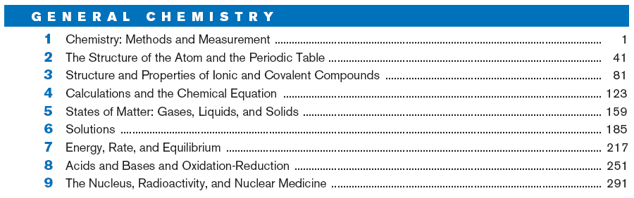
Schedule of topics
  Weeks 1-4 (February 25 to March 18)
    General chemistry
    Chapters 1-8

Slide 11
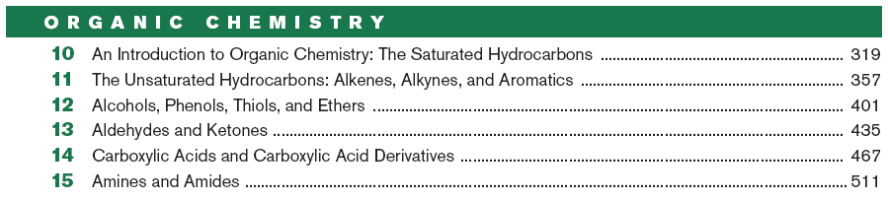
Schedule of topics
  Weeks 5-8 (March 25 to April 29)
    Organic chemistry
    Chapters 10-15

Slide 12
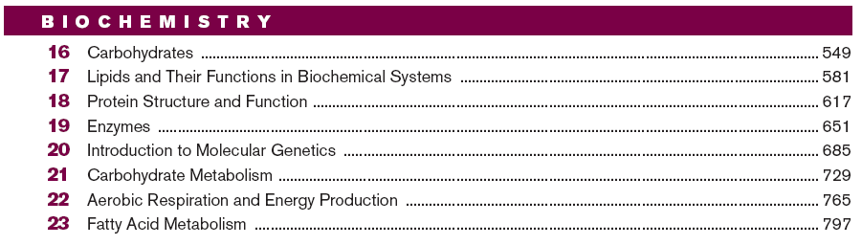
Schedule of topics
  Weeks 9-11 (May 6 to May 20)
    Biochemistry
    Chapters 16-20

Slide 13
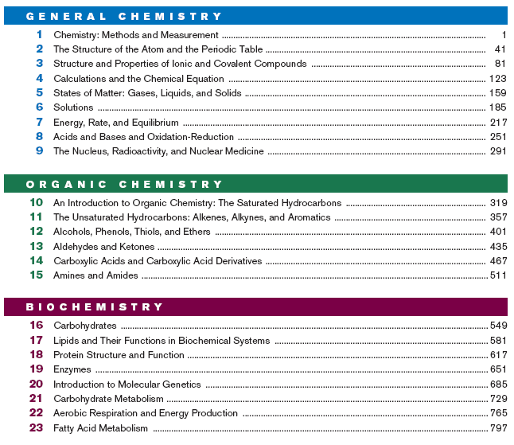
Schedule of topics
  Week 12 (May 27)
    Exam revision
    Chapters 1-8,10-20

Slide 14
Assessment
Practical reports
  25% (2% or 3% per report)
  Weekly submission by e-mail
Assignment
  20%
  Electronic submission by May 31
Exam I (mid-semester)
  15%
  In class during week 7 (April 22)
Exam II (end of semester)
  40%
  Exam period, from June 15 to July 3

Slide 15
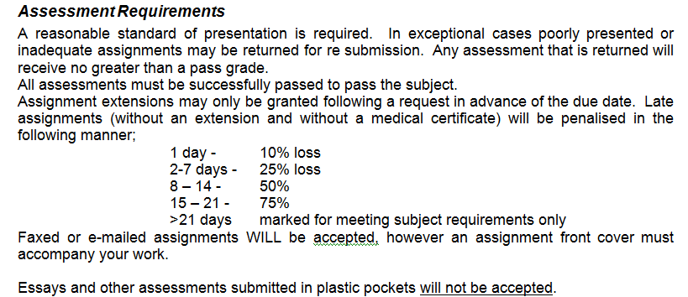
Assessment requirements

Slide 16
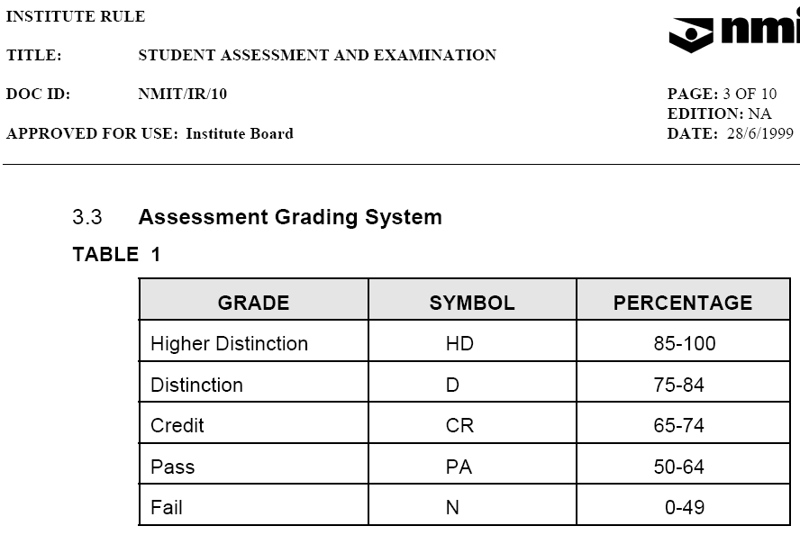
Assessment grading

Slide 17
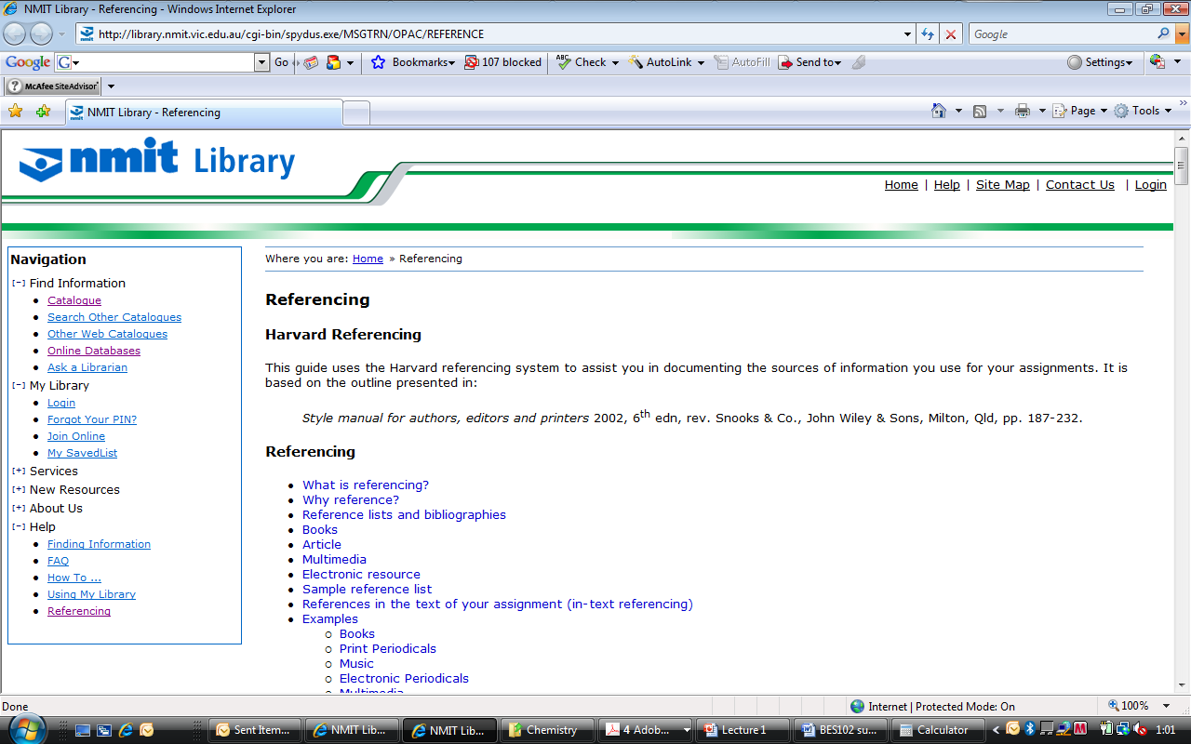
Referencing

Slide 18
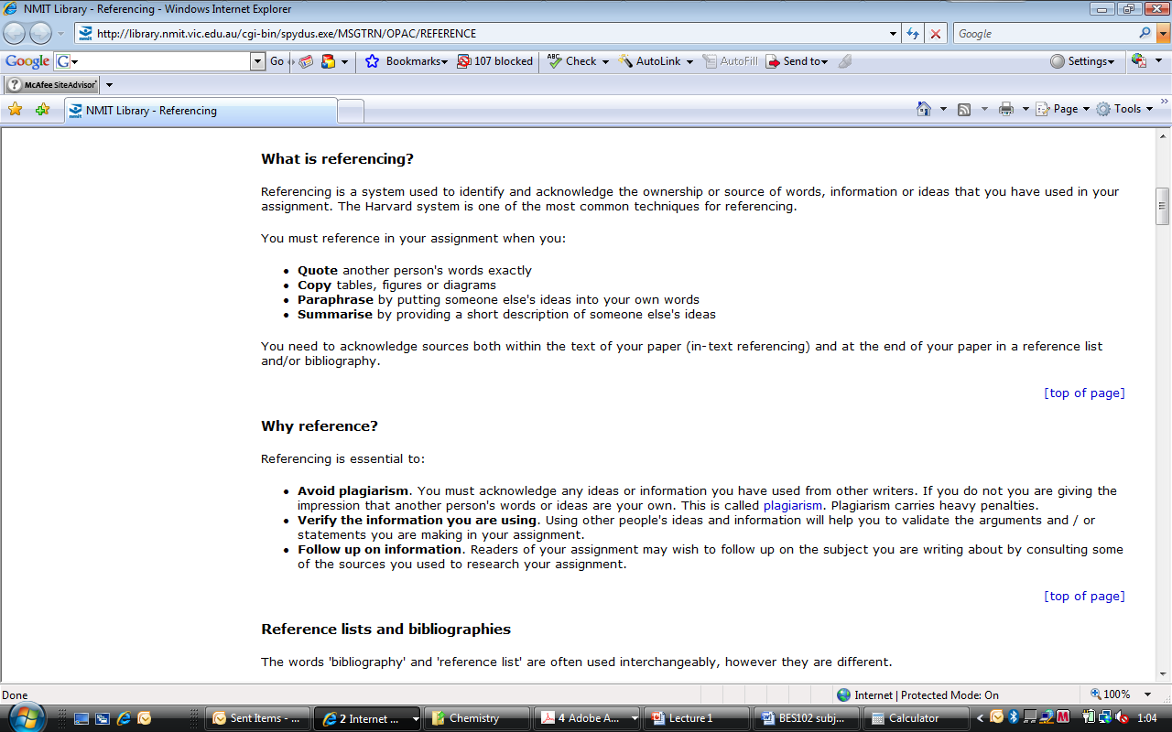
Referencing

Slide 19
Referencing

Slide 20
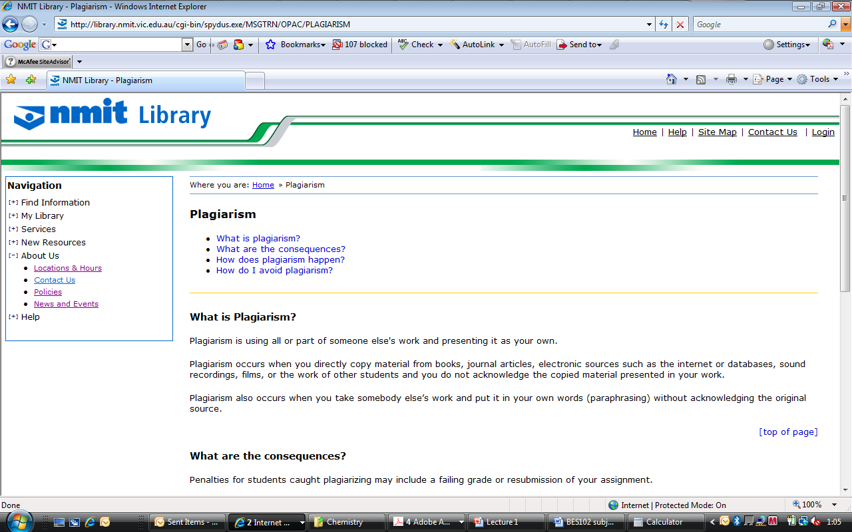
Plagiarism

Slide 21
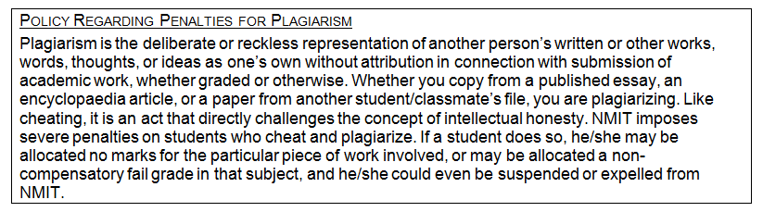
Plagiarism policy

Slide 22
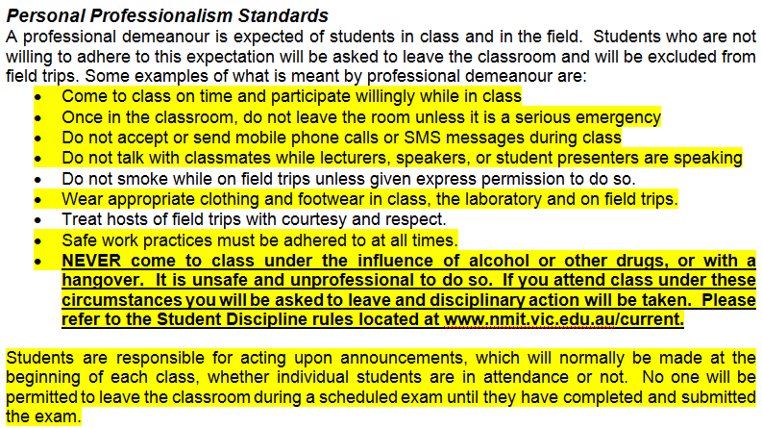
Personal Professionalism

Slide 23
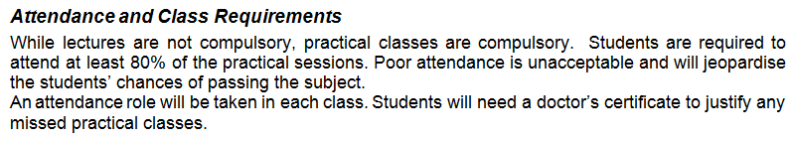
Class attendance
Lecture attendance not compulsory
Prac class attendance is compulsory
  Absences can only be due to illness
  All must be supported by a medical certificate
  Even with a medical certificate, must attend 9 of the 11 classes.
    This meets the 80% attendance requirements

Slide 24
How to contact me
Only on campus Wednesdays, for this subject
Can meet you on other days elsewhere
  Monash University, Clayton campus
  The University of Melbourne, Parkville campus
  RMIT University, City campus
E-mail
  pbutton@unimelb.edu.au
Mobile
  0412 342233

