Slide 1

Introduction to science and chemistry
Lecture 2 for BES102 & BVW102
25 February 2009
Philip Button
Department of Agriculture and Animal Science
Northern Melbourne Institute of TAFE

Slide 2
Lecture 2 objectives
Understand what chemistry is and appreciate it’s diversity
Know
  What the scientific method is
  Difference between physical/chemical properties
  How matter can be classified
  Difference between an extensive and an intensive property
  How matter and energy is measured, using what apparatus and how it can be reported
  Difference between accuracy and precision

Slide 3
What is chemistry?
Study of
  Matter
    Properties (chemical and physical)
    Changes (chemical and physical)
    Energy involved in those changes
Major areas of chemistry
  Biochemistry
  Organic chemistry
  Inorganic chemistry
  Physical chemistry
  Analytical chemistry

Slide 4
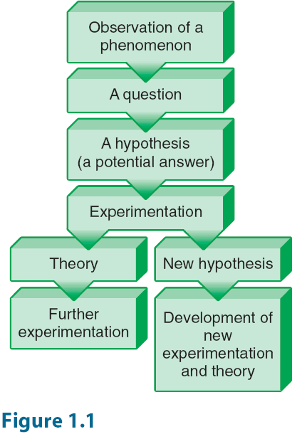
Scientific method

Slide 5

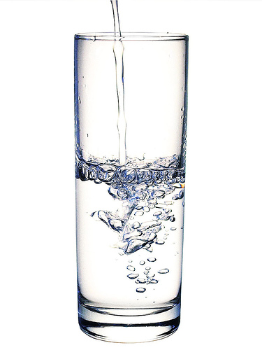
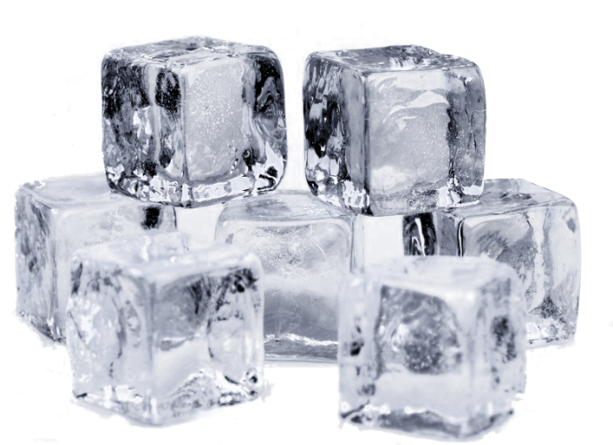
Matter and physical properties
Physical states of matter
Physical changes
  Appearance altered
  Composition and identity not altered
Examples of physical properties
  Melting point
  Boiling point

Slide 6

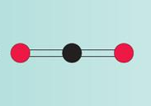
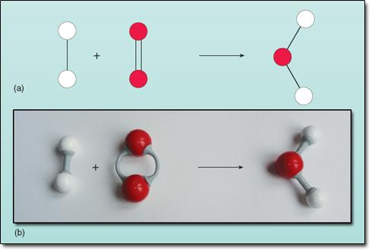
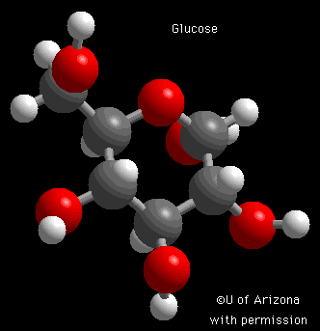
Matter and chemical properties
Change in composition or identity
Rearrangement, replacement, addition of atoms
Chemical reactions are the process

Slide 7
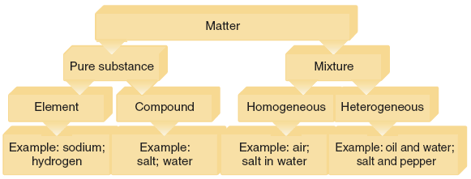
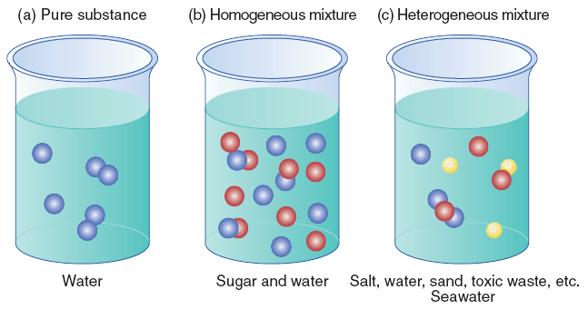
Classification of matter

Slide 8
Intensive and extensive properties
Intensive
  Independent of the quantity
    Density
Extensive
  Dependent on the quantity
    Mass

Slide 9
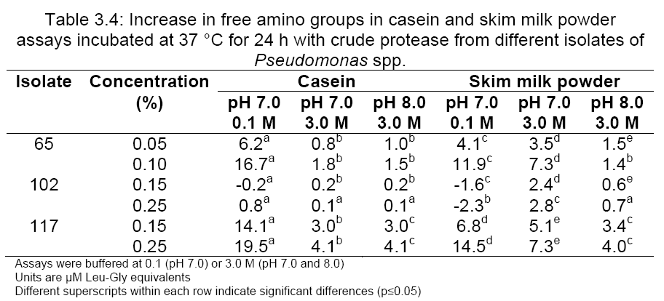
Data, results and units
Results are made up of data
Data is only meaningful with units of measurement

Slide 10

Units of measurement
Metric system developed in the 1780s
SI system developed in France in 1960
Base units form the basis of the system, e.g.
  Kelvin (K) for temperature
  Kilogram (kg) for mass
  Metre (m) for length
  Mole (mol) for amount of substance
Derived units
  Joule (J) for energy
  Katal (kat) for catalytic activity

Slide 11
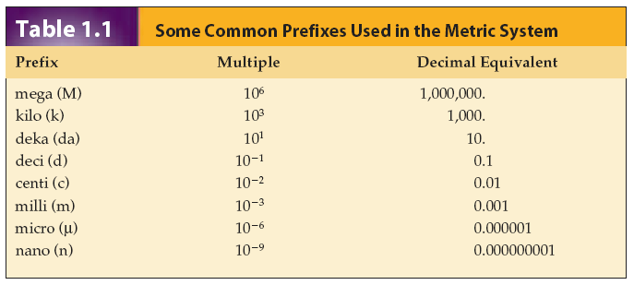
Units of measurement
Factor of 1000 for conversion from one to another
Start with 1 L
  1000 mL in 1 L
  1000 μL in 1 mL
  1000 nL in 1 μL

Slide 12
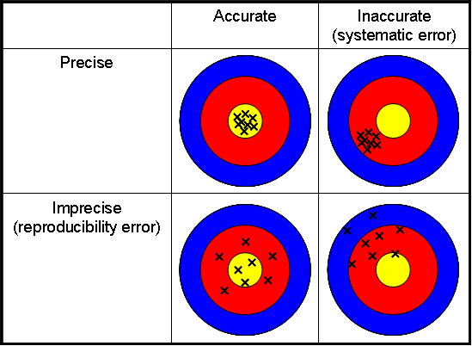
Accuracy and precision
Accuracy
  Ability to get close to the target or correct value
Precision
  Ability to reproduce a result

Slide 13
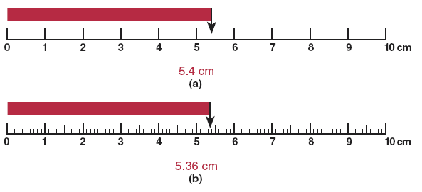
Significant figures
Associated with the degree of error
Error
  How certain you are of a result
Refers to the total number of digits
  5.4 has two significant figures
  5.36 has three significant figures

Slide 14
Scientific notation
Sometimes numbers too large or too small to be written out “normally”
Sometimes units do not exist
Standard for any number that would have to be converted by a factor of 10⁹

Slide 15
Scientific notation
  Example: mass of a helium atom
  6.692 x 10⁻²⁴ g
  0.000000000000000000000006692 g
  0.000000000000000000006692 mg
  0.000000000000000006692 μg
  0.000000000000006692 ng
  0.000000000006692 pg
  0.000000006692 fg
  0.000006692 ag
  0.0006692 zg
  0.6692 yg

Slide 16
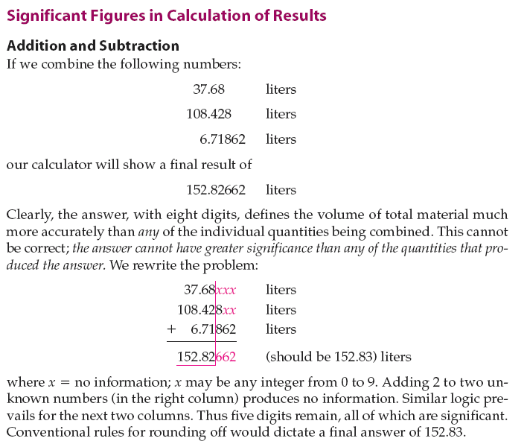
Significant figures in calculations

Slide 17
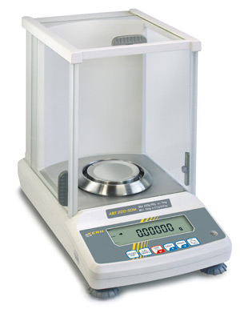
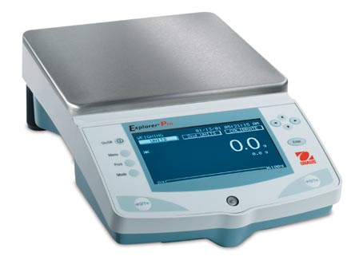
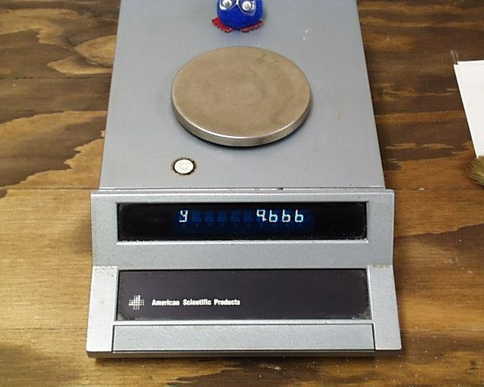
Mass
Mass and weight are different
  Mass is quantity of matter, independent of gravity
  Weight is the mass multiplied by the force of gravity
  Dalton (Da) or kilodalton (kDa) also used

Slide 18
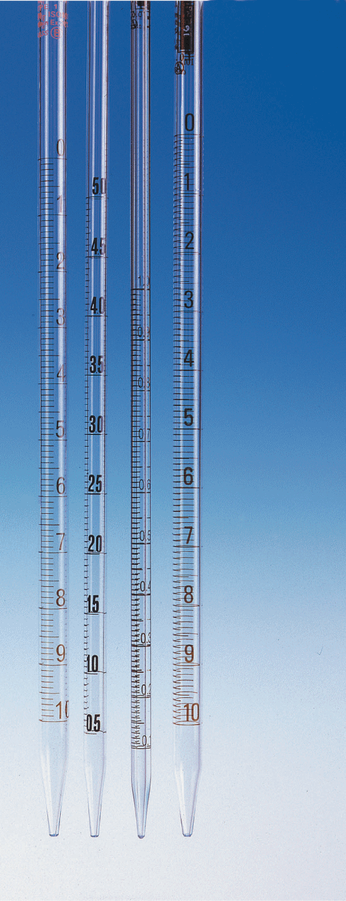
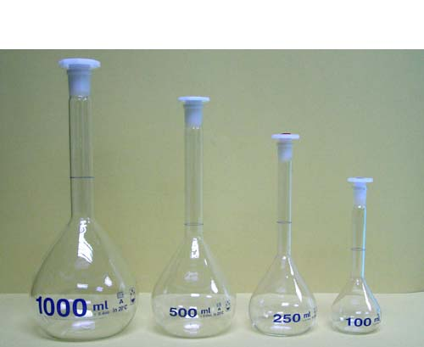
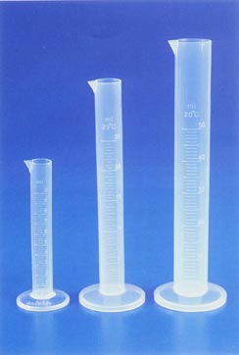
Volume
Space occupied by an object
Can vary with temperature

Slide 19
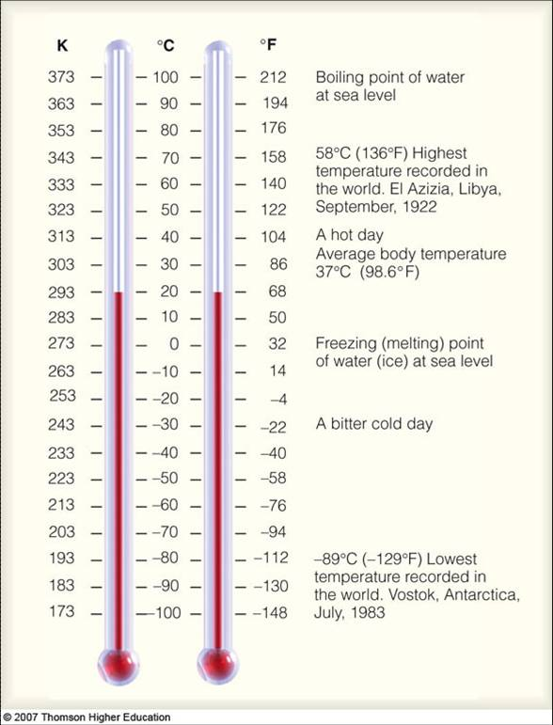
Temperature
Celsius scale is most
widely used
Kelvin is the SI unit,
but is not often used in
most areas of
chemistry

Slide 20
Energy
Energy is not created or destroyed but converted
Kinetic energy
  Energy in process
Potential energy
  Stored energy
Joule is the SI unit, but kilojoules used most
Energy required to
  Iron: 10 kJ/min
  Rake leaves: 17 kJ/min
  Walk: 25 kJ/min

Slide 21


Density and specific gravity
Mass and volume are extensive properties
Density is an intensive property
  Mass divided volume
Water at 4 °C has a density of 1.000
  Used as a reference point
Specific gravity
  Density of an object divided density of water at 4 °C

Slide 22
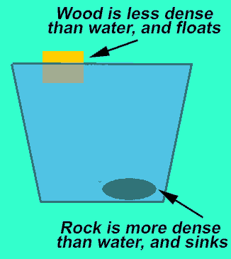
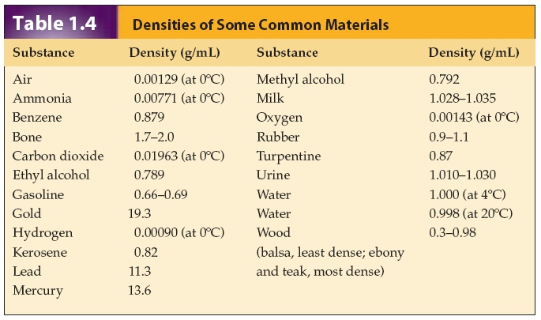
Density and specific gravity

