Slide 1

Atomic structure and the periodic table
Lecture 3 for BES102 & BVW102
4 March 2009
Philip Button
Department of Agriculture and Animal Science
Northern Melbourne Institute of TAFE

Slide 2
Lecture 3 objectives
Understanding of:
  Structure of the atom
    Protons, neutrons, electrons and quarks
    Relative size of subatomic particles
  Difference between atomic number/mass
  What isotopes are
  Calculation of atomic mass from mass of the isotopes and relative abundance
  Charges between atoms
  Importance of the periodic table to determining relationships between elements
  Valence electrons and the octet rule

Slide 3
2.1 Composition of the atom
Atom - the basic structural unit of an element
The smallest unit of an element that retains the chemical properties of that element

Slide 4
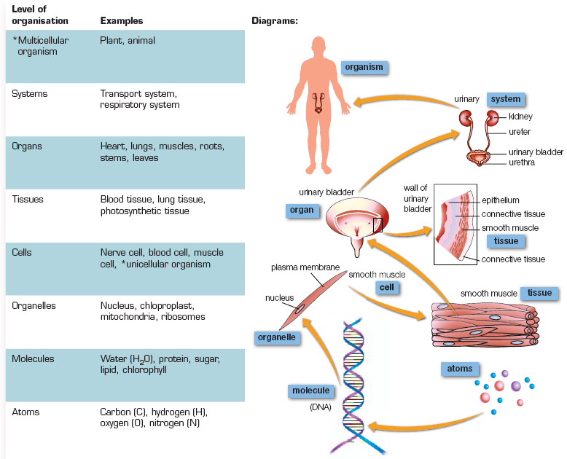

Slide 5
Electrons, protons and neutrons
Atoms consist of three primary particles
    electrons
    protons
    neutrons
2.1 Composition of the Atom
Nucleus - small, dense, positively charged region in the centre of the atom
  protons - positively charged particles
  neutrons - uncharged particles

Slide 6
Characteristics of atomic particles
Electrons are negatively charged particles located outside of the nucleus of an atom
Protons and electrons have charges that are equal in magnitude but opposite in sign
A neutral atom that has no electrical charge has the same number of protons and electrons
Electrons move very rapidly in a relatively large volume of space while the nucleus is small and dense
2.1 Composition of the Atom

Slide 7
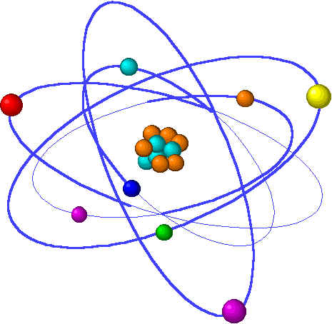
Characteristics of atomic particles
2.1 Composition of the Atom

Slide 8
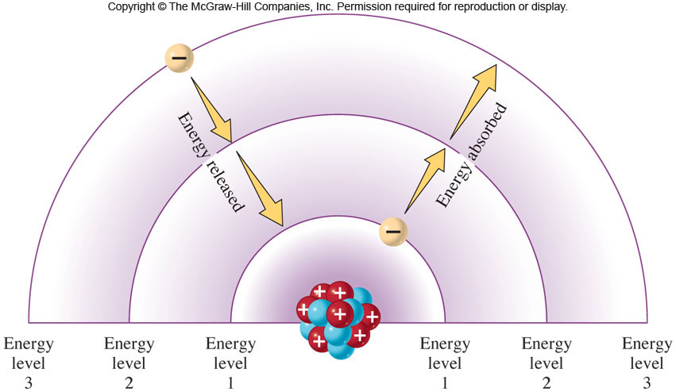
Fig. 2.9

Slide 9
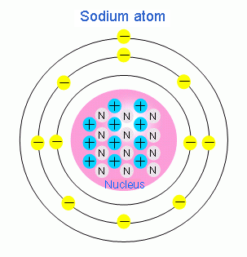

Slide 10

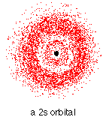


Slide 11
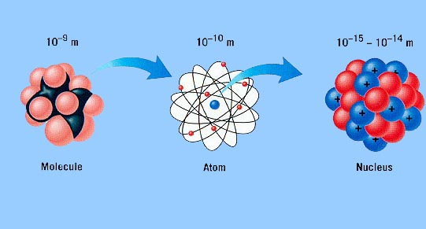
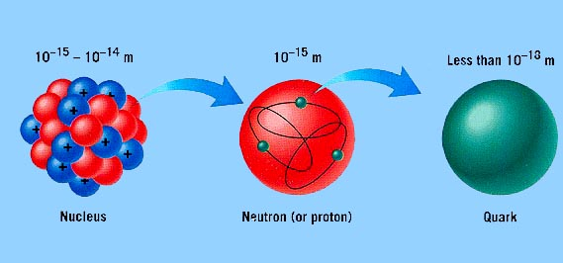
Characteristics of atomic particles
2.1 Composition of the Atom

Slide 12
Characteristics of atomic particles
Relative size of particles of the atom are as follows:
  Quark / electron 1 cm diameter
  Proton / neutrons 10 m diameter
  Nucleus 100 m diameter
  Atom 1000 km diameter
2.1 Composition of the Atom

Slide 13
Symbolic element representation
Charge of particle
Mass
Number
2.1 Composition of the Atom
Atomic Number
Symbol of
the atom
Atomic number (Z) - the number of protons in the atom
Mass number (A) - sum of the number of protons and neutrons

Slide 14
Atomic calculations
number of protons + number of neutrons = mass number
number of neutrons = mass number - number of protons
2.1 Composition of the Atom
number of protons = number of electrons IF positive and negative charges cancel, the atom Charge = 0

Slide 15
Selected properties of the three basic subatomic particles
Name Charge Mass(daltons) Mass (grams)
Electrons (e) -1 5.4 x 10⁻⁴ 9.1095 x 10⁻²⁸
Protons (p) +1 1.00 1.6725 X 10⁻²⁴
Neutrons (n) 0 1.00 1.6750 x 10⁻²⁴
2.1 Composition of the Atom

Slide 16
Determining the atomic composition
Calculate the number of protons, neutrons and electrons in each of the following:
2.1 Composition of the Atom

Slide 17
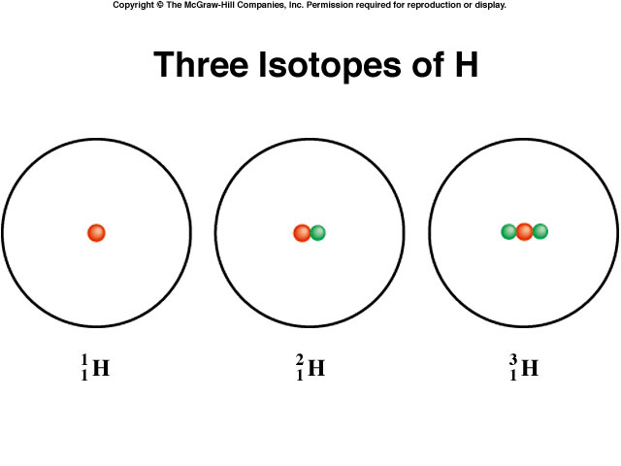
Isotopes
Isotopes - atoms of the same element having different masses
  contain same number of protons
  contain different numbers of neutrons
4
2.1 Composition of the Atom
Isotopes of Hydrogen
Hydrogen
(Hydrogen - 1)
Deuterium
(Hydrogen - 2)
Tritium
(Hydrogen - 3)

Slide 18
Isotopic calculations
Isotopes of the same element have identical chemical properties
Some isotopes are radioactive
Find chlorine on the periodic table
What is the atomic number of chlorine?
      17
What is the mass given
      35.453 Da
This is not the mass number of an isotope
2.1 Composition of the Atom

Slide 19
Atomic mass
The atomic mass - the weighted average of the masses of all the isotopes that make up chlorine
Chlorine consists of:
  chlorine-35 (isotopic mass 34.969: 75.77%)
  chlorine-37 (isotopic mass 36.966: 24.23%)
  roughly in a 3:1 ratio
Weighted average is an average corrected by the relative amounts of each isotope present in nature
2.1 Composition of the Atom

Slide 20
Determining atomic mass
Calculate the atomic mass of naturally occurring chlorine if 75.77% of chlorine atoms are chlorine-35 and 24.23% of chlorine atoms are chlorine-37
Step 1: convert the percentage to a decimal fraction
0.7577 chlorine-35
0.2423 chlorine-37
2.1 Composition of the Atom

Slide 21
Step 2: Multiply the decimal fraction by the mass of that isotope to obtain the isotope contribution to the atomic mass.
For chlorine-35:
0.7577 x 34.969 Da = 26.496 Da
For chlorine-37
0.2423 x 36.966 Da = 8.957 Da
Step 3: sum these partial weights to obtain the weighted average atomic mass of chlorine:
26.496 Da + 8.957 Da = 35.453 Da
2.1 Composition of the Atom

Slide 22
Atomic mass determination
Nitrogen consists of two naturally occurring isotopes
  99.63% nitrogen-14 with a mass of 14.003 Da
  0.37% nitrogen-15 with a mass of 15.000 Da
What is the atomic mass of nitrogen?
2.1 Composition of the Atom

Slide 23
Ions
Ions - electrically charged particles that result from a gain or loss of one or more electrons by the parent atom
Cation - positively charged
  result from the loss of electrons
  ²³Na → ²³Na⁺ + 1e⁻
Anion - negatively charged
  results from the gain of electrons
  ¹⁹F + 1 e⁻ → ¹⁹F⁻
2.1 Composition of the Atom

Slide 24
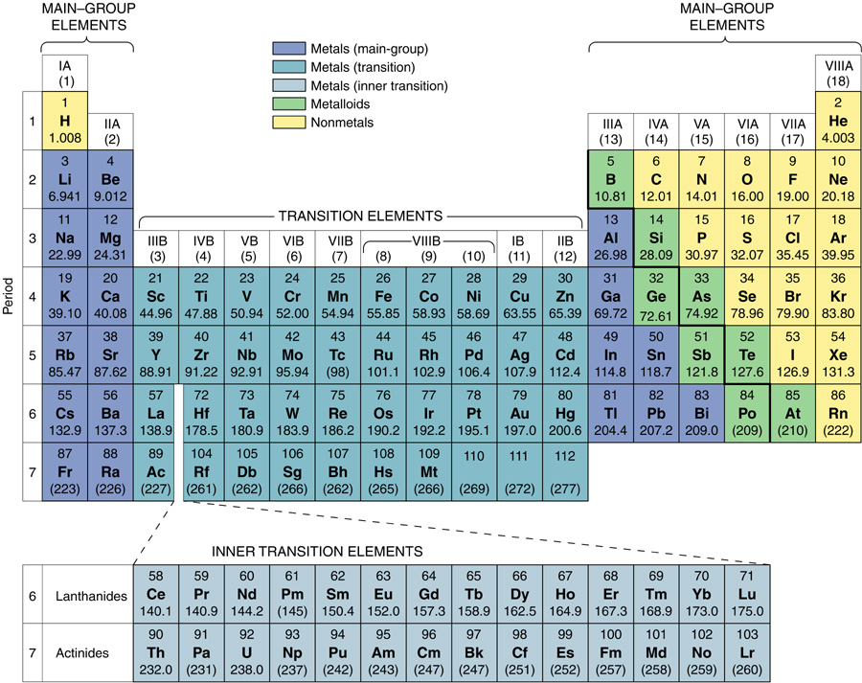
Classification of the elements
2.4 The Periodic Law and the Periodic Table

Slide 25
Parts of the periodic table
Period – a horizontal row of elements in the periodic table. They contain 2, 8, 8, 18, 18, and 32 elements,
Group – also called families are columns of elements in the periodic table.
2.4 The Periodic Law and the Periodic Table

Slide 26
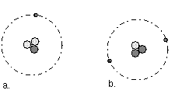
Parts of the periodic table
Elements in a particular group or family share many similarities, as in a human family.
2.4 The Periodic Law and the Periodic Table

Slide 27
Category classification of elements
Metals - elements that tend to lose electrons during chemical change, forming positive ions.
Nonmetals - a substance whose atoms tend to gain electrons during chemical change, forming negative ions.
Metalloids - have properties intermediate between metals and nonmetals.
2.4 The Periodic Law and the Periodic Table

Slide 28
Classification of elements
Metals
Metals:
  A substance whose atoms tend to lose electrons during chemical change
  Elements found primarily in the left ⅔ of the periodic table
Properties:
  High thermal and electrical conductivities
  High malleability and ductility
  Metallic luster
  Solid at room temperature
2.4 The Periodic Law and the Periodic Table

Slide 29
Classification of elements Nonmetals
Nonmetals:
  A substance whose atoms may gain electrons, forming negative ions
  Elements found in the right ⅓ of the periodic table
Properties:
  Brittle
  Powdery solids or gases
  Opposite of metal properties
2.4 The Periodic Law and the Periodic Table

Slide 30
2.5 Electron arrangement and the periodic table
The electron arrangement is the primary factor in understanding how atoms join together to form compounds
Electron configuration - describes the arrangement of electrons in atoms
Valence electrons - outermost electrons
  The electrons involved in chemical bonding

Slide 31
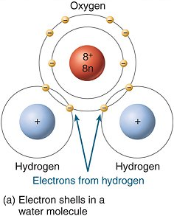
2.5 Electron arrangement and the periodic table

Slide 32
2.6 The Octet rule
The noble gases are extremely stable
  Called inert as they don’t readily bond to other elements
The stability is due to a full complement of valence electrons in the outermost s and p sublevels:
  2 electrons in the 1s of Helium
  the s and p subshells full in the outermost shell of the other noble gases (eight electrons)

Slide 33
The Octet rule
Octet rule - elements usually react in such a way as to attain the electron configuration of the noble gas closest to them in the periodic table
  Elements on the right side of the table move right to the next noble gas
  Elements on the left side move “backwards” to the noble gas of the previous row
Atoms will gain, lose or share electrons in chemical reactions to attain this more stable energy state
2.6 The Octet Rule

Slide 34
Classification of the elements
2.4 The Periodic Law and the Periodic Table

