Slide 1

Chemical bonding and compounds
Lecture 4 for BES102 & BVW102
4 March 2009
Philip Button
Department of Agriculture and Animal Science
Northern Melbourne Institute of TAFE

Slide 2
Lecture 4 objectives
Understanding of:
  How to draw Lewis symbols and what they represent
  Covalent and ionic bonding in compounds
    What they are
    Different properties of compounds with these bonds
  How to name compounds with covalent and ionic bonds
  What polarity is
  What multiple covalent bonds represents

Slide 3
3.1 Chemical bonding
Chemical bond - the force of attraction between any two atoms in a compound
This attractive force overcomes the repulsion of the positively charged nuclei of the two atoms participating in the bond
Interactions involving valence electrons are responsible for the chemical bond

Slide 4
Lewis symbols
Lewis symbol (Lewis structure) - a way to represent atoms using the element symbol and valence electrons as dots
As only valence electrons participate in bonding, this makes it much easier to work with the octet rule
The number of dots used corresponds directly to the number of valence electrons located in the outermost shell of the atoms of the element
3.1 Chemical Bonding

Slide 5
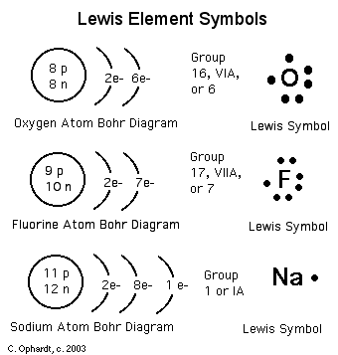
Lewis symbols
Using Lewis symbols
  Place one dot on each side until there are four dots around the symbol
  Now add a second dot to each side in turn
  The number of valence
  electrons limits the number of
  dots placed
  Each unpaired dot
  (unpaired electron of the
  valence shell) is available to
  form a chemical bond
3.1 Chemical Bonding

Slide 6
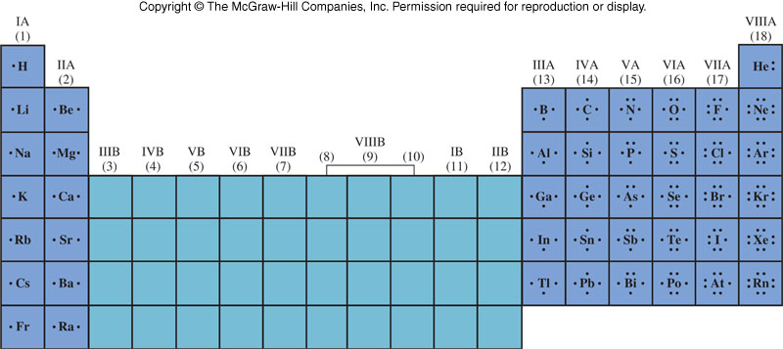
Lewis dot symbols for representative elements
3.1 Chemical Bonding

Slide 7
Principal types of chemical bonds: ionic and covalent
Ionic bond - a transfer of one or more electrons from one atom to another
  Forms attractions due to the opposite charges of the atoms
Covalent bond - attractive force due to the sharing of electrons between atoms
Some bonds have characteristics of both types and not easily identified as one or the other
3.1 Chemical Bonding

Slide 8
Ionic bonding
Representative elements form ions that obey the octet rule
Ions of opposite charge attract each other creating the ionic bond
When electrons are lost by a metal and electrons are gained by a nonmetal
  Each atom achieves a “Noble Gas” configuration
  2 ions are formed; a cation and anion, which are attracted to each other
3.1 Chemical Bonding

Slide 9
Ionic bonding
Consider the formation of NaCl
Na + Cl → NaCl
Chlorine has a high
electron affinity
When chlorine gains
an electron, it gains
the Ar configuration
3.1 Chemical Bonding
Sodium has a low
ionisation energy it
readily loses this
electron
Na → Na⁺ + e⁻
When sodium loses the
electron, it gains the
Ne configuration

Slide 10
Covalent bonding
Let’s look at the formation of H₂:
H + H → H₂
Each hydrogen has one electron in its valance shell
If it were an ionic bond it would look like this:
However, both hydrogen atoms have an equal tendency to gain or lose electrons
Electron transfer from one H to another usually will not occur under normal conditions
3.1 Chemical Bonding

Slide 11
Instead, each atom attains a noble gas configuration by sharing electrons
3.1 Chemical Bonding
Each hydrogen atom now has two electrons around it and attained a He configuration
The shared
electron
pair is called a
Covalent Bond

Slide 12
3.2 Naming compounds and writing formulas of compounds
Nomenclature - the assignment of a correct and unambiguous name to each and every chemical compound
Two naming systems:
  ionic compounds
  covalent compounds

Slide 13
Formulas of compounds
A formula is the representation of the fundamental compound using chemical symbols and numerical subscripts
  The formula identifies the number and type of the various atoms that make up the compound unit
  The number of like atoms in the unit is shown by the use of a subscript
  Presence of only one atom is understood when no subscript is present
3.2 Naming Compounds and Writing Formulas of Compounds

Slide 14
Ionic compounds
Metals and nonmetals usually react to form ionic compounds
The metals are cations and the nonmetals are anions
The cations and anions arrange themselves in a regular three-dimensional repeating array called a crystal lattice
Formula of an ionic compound is the smallest whole-number ratio of ions in the substance
3.2 Naming Compounds and Writing Formulas of Compounds

Slide 15
Writing formulas of ionic compounds from the identities of the component Ions
Determine the charge of each ion
  Metals have a charge equal to group number
  Nonmetals have a charge equal to the group number minus eight
Cations and anions must combine to give a formula with a net charge of zero
  It must have the same number of positive charges as negative charges
3.2 Naming Compounds and Writing Formulas of Compounds

Slide 16
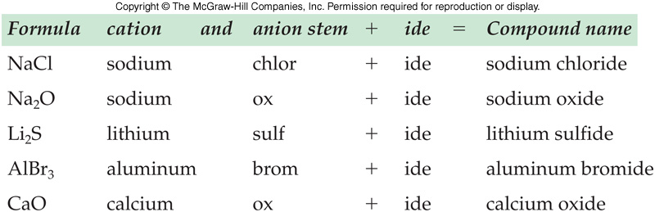
Writing names of ionic compounds from the for the compound
Name the cation followed by the name of the anion
A positive ion retains the name of the element; change the anion suffix to -ide
3.2 Naming Compounds and Writing Formulas of Compounds

Slide 17
Writing names of ionic compounds from the formula of the compound
If the cation of an element has several ions of different charges (as with transition metals) use a Roman numeral following the metal name
  Roman numerals give the charge of the metal
Examples:
  FeCl₃ is iron(III) chloride
  FeCl₂ is iron(II) chloride
  CuO is copper(II) oxide
3.2 Naming Compounds and Writing Formulas of Compounds

Slide 18
Covalent compounds
Covalent compounds are typically formed from nonmetals
Molecules - compounds characterised by covalent bonding
  Not a part of a massive three-dimensional crystal structure (H₂O, N₂, CH₄, HCl)
  Exist as discrete molecules in the solid, liquid, and gas states
3.2 Naming Compounds and Writing Formulas of Compounds

Slide 19
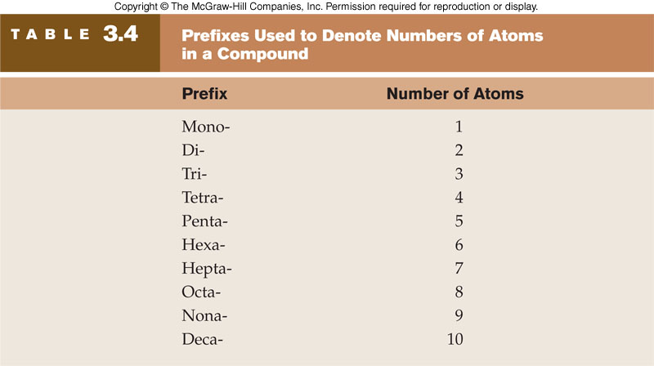
Naming covalent compounds
The names of the elements are written in the order in which they appear in the formula
A prefix indicates the number of each kind of atom
3.2 Naming Compounds and Writing Formulas of Compounds

Slide 20
Naming covalent compounds
If only one atom of a particular element is present in the molecule, the prefix mono- is usually omitted from the first element
Example: CO is carbon monoxide
The stem of the name of the last element is used with the suffix –ide
The final vowel in a prefix is often dropped before a vowel in the stem name
3.2 Naming Compounds and Writing Formulas of Compounds

Slide 21
Writing formulas of covalent compounds
Use the prefixes in the names to determine the subscripts for the elements
Examples:
  nitrogen trichloride NCl₃
  diphosphorus pentoxide P₂O₅
Some common names that are used:
  H₂O water
  NH₃ ammonia
  C₂H₅OH ethanol
  C₆H₁₂O₆ glucose
3.2 Naming Compounds and Writing Formulas of Compounds

Slide 22
3.3 Properties of ionic and covalent compounds
Physical state
  Ionic compounds are usually solids at room temperature
  Covalent compounds can be solids, liquids, and gases
Melting and boiling points
  Melting point - the temperature at which a solid is converted to a liquid
  Boiling point - the temperature at which a liquid is converted to a gas

Slide 23
Physical properties
Melting and Boiling Points
  Ionic compounds have much higher melting points and boiling points than covalent compounds
  A large amount of energy is required to break the electrostatic attractions between ions
  Ionic compounds typically melt at several hundred degrees Celsius
Structure of Compounds in the Solid State
  Ionic compounds are crystalline
  Covalent compounds are crystalline or amorphous – having no regular structure
3.3 Properties of Ionic and Covalent Compounds

Slide 24
Physical properties
Solutions of ionic and covalent compounds
  Ionic compounds often dissolve in water, where they dissociate - form positive and negative ions in solution
  Electrolytes - ions present in solution allowing the solution to conduct electricity
  Covalent solids usually do not dissociate and do not conduct electricity - nonelectrolytes
3.3 Properties of Ionic and Covalent Compounds

Slide 25
Comparison of ionic versus covalent compounds
 | Ionic | Covalent
Composed of | Metal + nonmetal | 2 nonmetals
Electrons | Transferred | Shared
Physical state | Solid / crystal | Any / crystal OR amorphous
Dissociation | Yes, electrolytes | No, nonelectrolytes
Boiling/Melting | High | Low
3.3 Properties of Ionic and Covalent Compounds

Slide 26
Lewis structure, stability, multiple bonds and bond energies
Single bond - one pair of electrons are shared between two atoms
Double bond - two pairs of electrons are shared between two atoms
Triple bond - three pairs of electrons are shared between two atoms
  Very stable
3.4 Drawing Lewis Structures of Molecules

Slide 27
Lewis structures and polarity
A molecule is polar if its centres of positive and negative charges do not coincide
Polar molecules when placed in an electric field will align themselves in the field
  Molecules that are polar behave as a dipole (having two “poles” or ends)
  One end is positively charged the other is negatively charged
Nonpolar molecules will not align themselves in an electric field
3.4 Drawing Lewis Structures of Molecules

Slide 28
Boiling points of liquids and melting points of solids
Energy is used to overcome the intermolecular attractive forces in a substance, driving the molecules into a less associated phase
The greater the intermolecular force, the more energy is required leading to
  Higher melting point of a solid
  Higher boiling point of a liquid
3.5 Properties Based on Electronic Structure and Molecular Geometry

Slide 29
Factors influencing boiling and melting points
Strength of the attractive force holding the substance in its current physical state
Molecular mass
  Larger molecules have higher m.p. and b.p. than smaller molecules as it is more difficult to convert a larger mass to another phase
Polarity
  Polar molecules have higher m.p. and b.p. than nonpolar molecules of similar molecular mass due to their stronger attractive force
3.5 Properties Based on Electronic Structure and Molecular Geometry

Slide 30
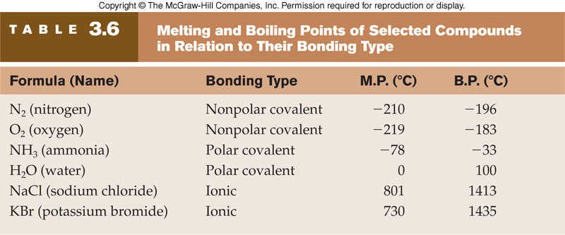
Melting and boiling points
– Selected compounds by bonding type
3.5 Properties Based on Electronic Structure and Molecular Geometry

