Slide 1

Acids, bases and the pH scale
Lecture 6 for BES102 & BVW102
11 March 2009
Philip Button
Department of Agriculture and Animal Science
Northern Melbourne Institute of TAFE

Slide 2

Lecture 6 objectives
Understanding of:
  How an acid can be defined.
  How a base can be defined.
  What a strong acid or base is.
  Conjugate acids and bases.
  Definition of pH
  The pH scale.
  Principles of acid-base titrations.

Slide 3
8.1 Acids and bases
Acids: Taste sour, dissolve some metals, cause plant dye to change color
Bases: Taste bitter, are slippery, are corrosive
Two theories that help us to understand the chemistry of acids and bases
  Arrhenius Theory
  Brønsted-Lowry Theory

Slide 4
Brønsted-Lowry theory of acids and bases
Acid - proton donor
Base - proton acceptor
  Notice that acid and base are not defined using water
  When writing the reactions, both accepting and donation are evident
8.1 Acids and Bases

Slide 5
Brønsted-Lowry theory of acids and bases
HCl(aq) + H₂O(l) → Cl⁻(aq) + H₃O⁺(aq)
What donated the proton? HCl
Is it an acid or base? Acid
What accepted the proton? H₂O
Is it an acid or base? Base
acid
base
8.1 Acids and Bases

Slide 6
Brønsted-Lowry theory of acids and bases
NH₃(aq) + H₂O(l) NH₄⁺(aq) + OH⁻(aq)
base
acid
Now let us look at NH₃ and see why it is a base
Did NH₃ donate or accept a proton? Accept
Is it an acid or base? Base
What is water in this reaction? Acid
8.1 Acids and Bases

Slide 7
Acid-base properties of water
Water possesses both acid and base properties
  Amphiprotic – a substance possessing both acid and base properties
  Water is the most commonly used solvent for both acids and bases
  Solute-solvent interactions between water and both acids and bases promote solubility and dissociation
8.1 Acids and Bases

Slide 8
Acid and base strength
Acid and base strength – degree of dissociation
  Not a measure of concentration
  Strong acids and bases – reaction with water is virtually 100% (Strong electrolytes)
8.1 Acids and Bases

Slide 9
Strong acids and bases
Strong acids:
  HCl, HBr, HI hydrochloric acid, etc.
  HNO₃ nitric acid
  H₂SO₄ sulphuric acid
  HClO₄ perchloric acid
Strong bases:
  NaOH, KOH, Ba(OH)₂
  All metal hydroxides
8.1 Acids and Bases

Slide 10
Weak acids
Weak acids and bases – only a small percent dissociates (Weak electrolytes)
Weak acid examples:
  Acetic acid
  Carbonic Acid:
8.1 Acids and Bases
CH₃COOH(aq) + H₂O(l) CH₃COO⁻(aq) + H₃O⁺(aq)
H₂CO₃(aq) + H₂O(l) HCO₃⁻(aq) + H₃O⁺(aq)

Slide 11
Weak bases
Weak base examples:
  Ammonia:
  Pyridine:
  Aniline:
NH₃(aq) + H₂O(l) NH₄⁺(aq) + OH⁻(aq)
8.1 Acids and Bases
C₅H₅NH₂(aq) + H₂O(l) C₅H₅NH₃⁺(aq) + OH⁻(aq)
C₆H₅NH₂(aq) + H₂O(l) C₆H₅NH₃⁺(aq) + OH⁻(aq)

Slide 12
Conjugate acids and bases
The acid base reaction can be written in the general form:
Notice the reversible arrows
The products are also an acid and base called the conjugate acid and base
HA + B A⁻ + HB⁺
8.1 Acids and Bases
acid base

Slide 13
acid base
Conjugate acid – what the base becomes after it accepts a proton.
Conjugate base – what the acid becomes after it donates its proton
Conjugate acid-base pair – the acid and base on the opposite sides of the equation
HA + B A⁻ + HB⁺
base acid
8.1 Acids and Bases

Slide 14
Acid-base dissociation
HA + B A⁻ + HB⁺
The reversible arrow isn’t always written
  Some acids or bases essentially dissociate 100%
  One way arrow is used
HCl + H₂O → Cl⁻ + H₃O⁺
  All of the HCl is converted to Cl⁻
  HCl is called a strong acid – an acid that dissociates 100%
Weak acid - one which does not dissociate 100%
8.1 Acids and Bases

Slide 15
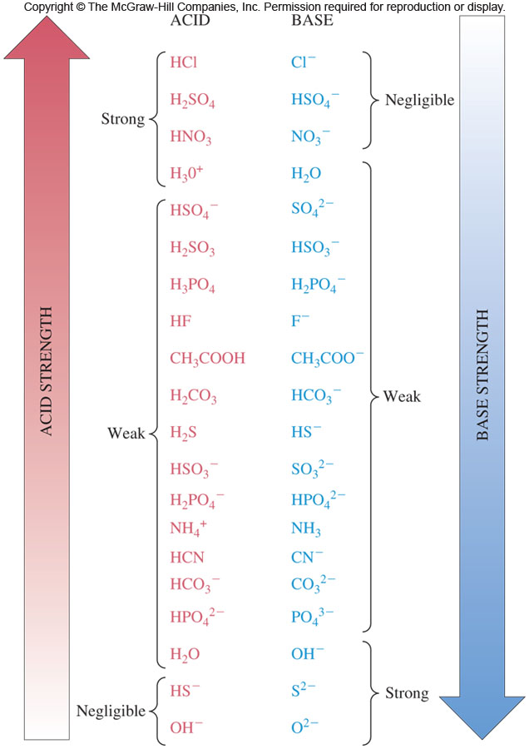
Conjugate acid-base pairs
Which acid is stronger:
HF or HCN? HF
Which base is stronger:
CN⁻ or H₂O? CN ⁻
8.1 Acids and Bases

Slide 16
8.2 pH: A measurement scale for acids and bases
pH scale – a scale that indicates the acidity or basicity of a solution
  Ranges from 0 (very acidic) to 14 (very basic)
The pH scale is rather similar to the temperature scale assigning relative values of hot and cold
The pH of a solution is defined as:
pH = -log[H₃O⁺]

Slide 17
A definition of pH
Use these observations to develop a concept of pH
  if know one concentration, can calculate the other
  if add an acid, [H₃O⁺] ↑ and [OH⁻] ↓
  if add a base, [OH⁻] ↑ and [H₃O⁺] ↓
  [H₃O⁺] = [OH⁻] when equal amounts of acid and base are present
8.2 pH: A Measurement Scale for Acids and Bases

Slide 18
Measuring pH
pH of a solution can be:
  Calculated if the concentration of either is known
    [H₃O⁺]
    [OH⁻]
  Approximated using indicator / pH paper that develops a color related to the solution pH
  Measured using a pH meter whose sensor measures an electrical property of the solution that is proportional to pH
8.2 pH: A Measurement Scale for Acids and Bases

Slide 19
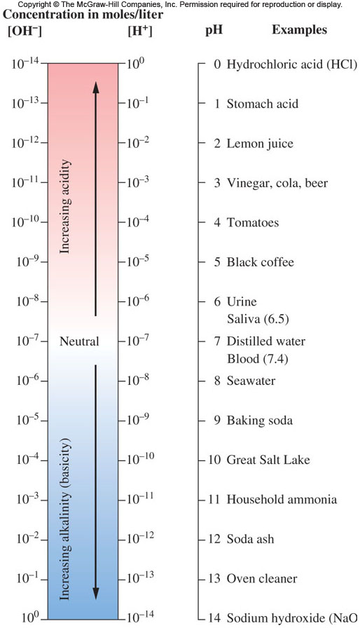
The pH scale
8.2 pH: A Measurement Scale for Acids and Bases

Slide 20
For a strong acid
HCl molarity pH
For a strong base
NaOH molarity pH
More Acidic
1 M 0.00
100 mM 1.00
10 mM 2.00
1 mM 3.00
100 μM 4.00
10 μM 5.00
1 μM 6.00
100 nL 7.00
1 M 14.00
100 mM 13.00
10 mM 12.00
1 mM 11.00
100 μM 10.00
10 μM 9.00
1 μM 8.00
100 nL 7.00
More basic
8.2 pH: A Measurement Scale for Acids and Bases
Each 10 fold change in concentration changes the pH by one unit

Slide 21
8.3 Reactions between acids and bases
Neutralisation reaction – the reaction of an acid with a base to produce a salt and water
HCl(aq) + NaOH(aq) → NaCl(aq) + H₂O(l)
Acid Base Salt Water
Break apart into ions:
H⁺ + Cl⁻ + Na⁺ + OH⁻ →Na⁺ + Cl⁻ + H₂O
Net ionic equation
  Show only the changed components
  Omit any ions appearing the same on both sides of equation = Spectator Ions
H⁺ + OH⁻ → H₂O

Slide 22
8.3 Reactions Between Acids and Bases
Net ionic neutralisation reaction
The net ionic neutralization reaction is more accurately written:
H₃O⁺(aq) + OH⁻(aq) → 2H₂O(l)
This equation applies to any strong acid / strong base neutralization reaction
An analytical technique to determine the concentration of an acid or base is titration
Titration involves the addition of measured amount of a standard solution to neutralize the second, unknown solution
Standard solution – solution of known concentration

Slide 23
Acid – base titration
Burette – long glass tube calibrated in mL which contains the standard solution
Standard solution is slowly added until the color changes
The equivalence point is when the moles of H₃O⁺ and OH⁻ are equal
Indicator – a substance which changes color as pH changes
8.3 Reactions Between Acids and Bases
Flask contains a solution of unknown concentration plus indicator

Slide 24
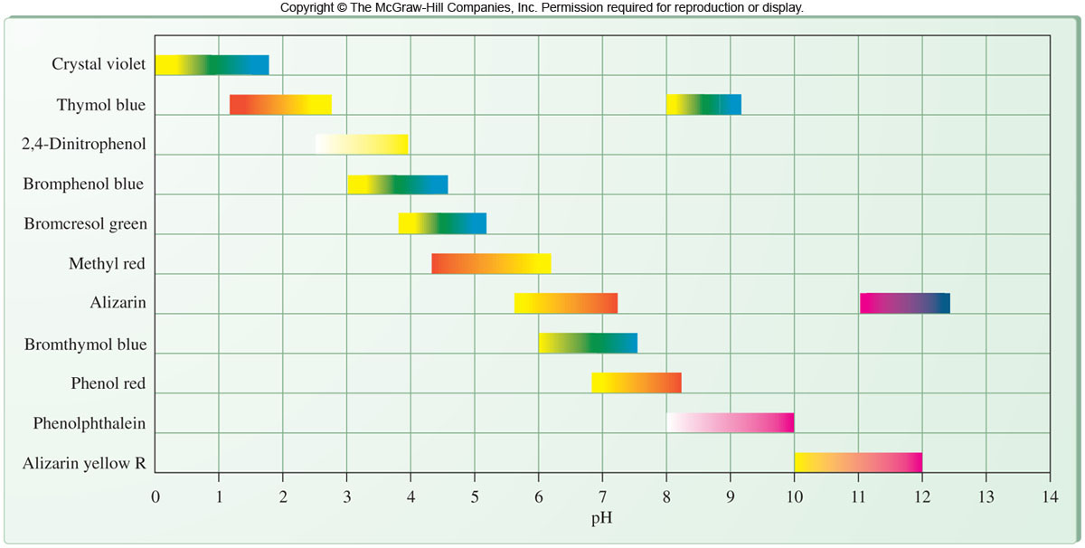
Relationship between pH and colour in acid-base indicators
8.3 Reactions Between Acids and Bases

Slide 25
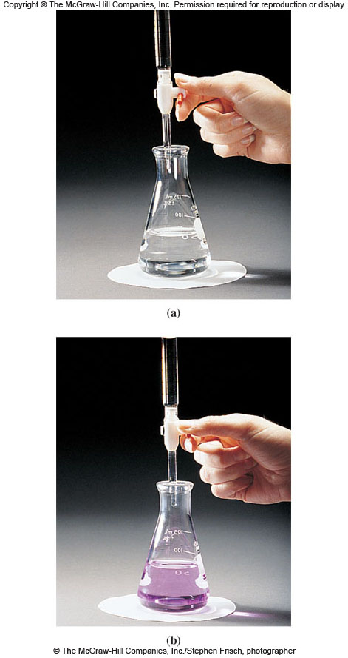
Determine the concentration of a solution of hydrochloric acid
Place a known volume of acid whose concentration is not known into a flask
Add an indicator, experience guides selection, here phenol red is good
Known concentration of NaOH is placed in a burette
Drip NaOH into the
flask until the indicator
changes colour
8.3 Reactions Between Acids and Bases

