Slide 1

Stoichiometry
Lecture 7 for BES102 & BVW102
18 March 2009
Philip Button
Department of Agriculture and Animal Science
Northern Melbourne Institute of TAFE

Slide 2
Lecture 7 objectives
Understanding of:
  What a mole is.
  What formula weight is and how to use it.
  Types of chemical equations.
  How to balance chemical equations.
  Law of conversation of mass

Slide 3
4.1 The mole concept and atoms
Atoms are exceedingly small
  Unit of measurement for mass of an atom is dalton (Da) – unit of measure for the mass of atoms
    carbon-12 assigned the mass of exactly 12 Da
    1 Da = 1.66 x 10⁻²⁴ g
Periodic table gives atomic weights in Da

Slide 4
The mole and Avogadro’s number
A practical unit for defining a collection of atoms is the mole
1 mole of atoms = 6.022 x 10²³ atoms
This is called Avogadro’s number
  This has provided the basis for the concept of the mole
4.1 The Mole Concept and Atoms

Slide 5
The mole
To make this connection we must define the mole as a counting unit
  The mole is abbreviated mol
A mole is simply a unit that defines an amount of something
  Dozen defines 12
4.1 The Mole Concept and Atoms

Slide 6
Atomic mass
The atomic mass of one atom of an element corresponds to:
  The average mass of a single atom in Da
  The mass of a mole of atoms in grams
  1 atom of F is 19.00 Da 19.00 Da/atom F
  1 mole of F is 19.00 g 19.00 g/mole F
4.1 The Mole Concept and Atoms
=19.00 g F/mol F or 19.00 g/mol F

Slide 7
4.2 The chemical formula, formula weight, and molar mass
Chemical formula - a combination of symbols of the various elements that make up the compound
Formula unit - the smallest collection of atoms that provide two important pieces of information
  The identity of the atoms
  The relative number of each type of atom

Slide 8
Chemical formula
Consider the following formulas:
H₂ – 2 atoms of hydrogen are chemically bonded forming diatomic hydrogen, subscript 2
H₂O – 2 atoms of hydrogen and 1 atom of oxygen, lack of subscript means one atom
NaCl – 1 atom each of sodium and chlorine
Ca(OH)₂ – 1 atom of calcium and 2 atoms each of oxygen and hydrogen, subscript outside parentheses applies to all atoms inside
4.2 The Chemical Formula, Formula Weight and Molar Mass

Slide 9
Chemical formula
Consider the following formulas:
(NH₄)₃SO₄ – 3 ammonium ions and 1 sulphate ion
  Ammonium ion contains 1 nitrogen and 4 hydrogen
  Sulphate ion contains 1 sulphur and 4 oxygen
  Compound contains 2 N, 8 H, 1 S, and 4 O
CuSO₄.5H₂O
  This is an example of a hydrate - compounds containing one or more water molecules as an integral part of their structure
  5 units of water with 1 CuSO₄
4.2 The Chemical Formula, Formula Weight and Molar Mass

Slide 10
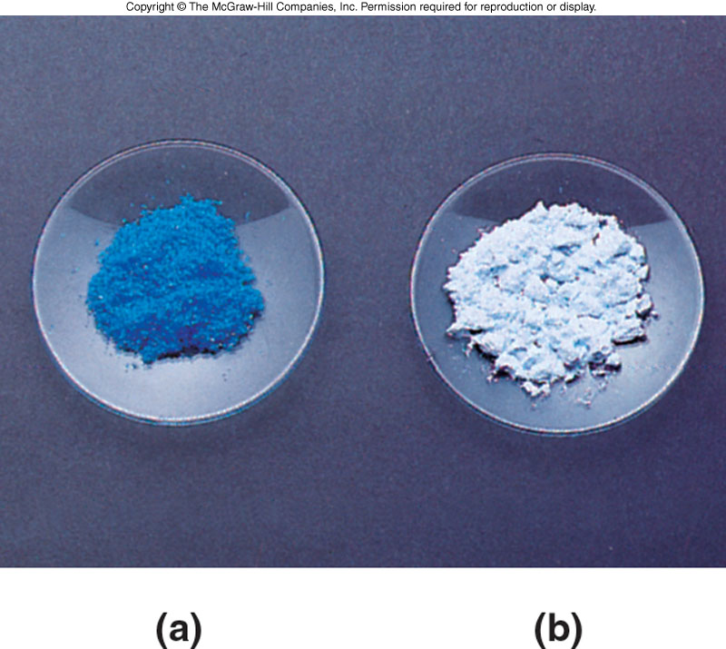
Comparison of hydrated and anhydrous copper sulphate
4.2 The Chemical Formula, Formula Weight and Molar Mass
Hydrated copper sulfate
Anhydrous copper sulfate
Marked color difference illustrates the fact that these are different compounds

Slide 11
Formula weight and molar mass
Formula weight - the sum of the atomic weights of all atoms in the compound as represented by its correct formula
  expressed in da
What is the formula weight of H₂O?
  16.00 Da + 2(1.008 Da) = 18.02 Da
Molar mass – mass of a mole of compound in grams / mole
  Numerically equal to the formula weight in da
What is the molar mass of H₂O?
  18.02 g/mol H₂O
4.2 The Chemical Formula, Formula Weight and Molar Mass

Slide 12
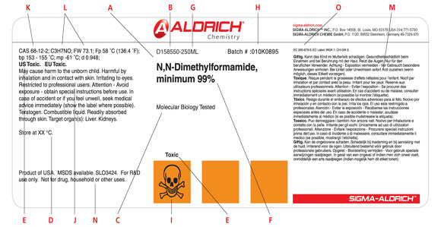
Formula weight and molar mass
4.2 The Chemical Formula, Formula Weight and Molar Mass

Slide 13
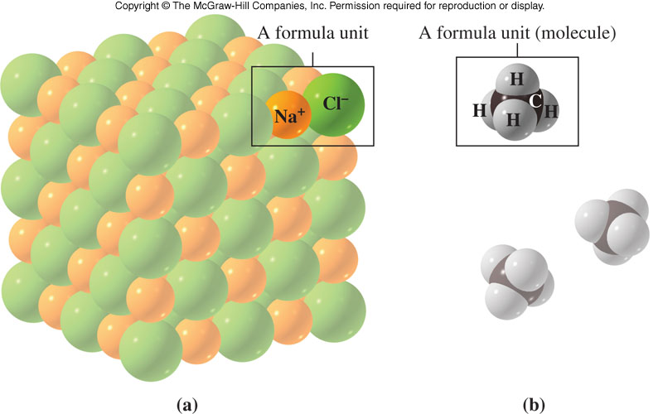
Formula unit
Formula unit – smallest collection of atoms from which the formula of a compound can be established
When calculating the formula weight (or molar mass) of an ionic compound, the smallest unit of the crystal is used
4.2 The Chemical Formula, Formula Weight and Molar Mass

Slide 14
Molar mass
Molar mass - The mass in grams of 1 mole of atoms
What is the molar mass of carbon?
12.01 g/mol C
This means counting out a mole of carbon atoms (i.e., 6.022 x 10²³) they would have a mass of 12.01 g
One mole of any element contains the same number of atoms, 6.022 x 10²³, Avogadro’s number
4.2 The Chemical Formula, Formula Weight and Molar Mass

Slide 15
4.3 The chemical equation and the information it conveys
A recipe for chemical change
Chemical equation - shorthand notation of a chemical reaction
  Describes all of the substances that react and all the products that form, physical states, and experimental conditions
  Reactants – (starting materials) – the substances that undergo change in the reaction
  Products – substances produced by the reaction

Slide 16
Features of a chemical equation
Identity of products and reactants must be specified using chemical symbols
Reactants are written to the left of the reaction arrow and products are written to the right
Physical states of reactants and products may be shown in parentheses
Symbol Δ over the reaction arrow means that energy is necessary for the reaction to occur
Equation must be balanced
4.3 The Chemical Equation
and the Information It Conveys

Slide 17
Features of a chemical equation
Products and reactants must be specified using chemical symbols
4.3 The Chemical Equation
and the Information It Conveys
Reactants – written on the left of arrow
Products – written on the right
Δ – energy is needed
Physical states are shown in parentheses

Slide 18
The experimental basis of a chemical equation
We know that a chemical equation represents a chemical change
  One or more substances changed into new substances
  Different chemical and physical properties
4.3 The Chemical Equation
and the Information It Conveys

Slide 19
Evidence of a reaction occurring
The following can be visual evidence of a reaction:
Release of a gas
  CO₂ is released when acid is placed in a solution containing CO₃²⁻ ions
Formation of a solid (precipitate)
  A solution containing Ag⁺ ions mixed with a solution containing Cl⁻ ions
Heat is produced or absorbed
  Acid and base are mixed together
Color changes
4.3 The Chemical Equation
and the Information It Conveys

Slide 20
Subtle indications of a reaction
Heat or light is absorbed or emitted
Changes in the way the substances behave in an electrical or magnetic field before and after a reaction
Changes in electrical properties
4.3 The Chemical Equation
and the Information It Conveys

Slide 21
Writing chemical reactions
We will learn to identify the following patterns of chemical reactions:
  combination
  decomposition
  single-replacement
  double-replacement
Recognising the pattern will help you write and understand reactions
4.3 The Chemical Equation
and the Information It Conveys

Slide 22
Combination reactions
The joining of two or more elements or compounds, producing a product of different composition
4.3 The Chemical Equation
and the Information It Conveys
A + B → AB
Examples:
2Na(s) + Cl₂(g) → 2NaCl(s)
MgO(s) + CO₂(g) → MgCO₃(s)

Slide 23
Types of combination reactions
Combination of a metal and a nonmetal to form a salt
Combination of hydrogen and chlorine molecules to produce hydrogen chloride
Formation of water from hydrogen and oxygen molecules
Reaction of magnesium oxide and carbon dioxide to produce magnesium carbonate
4.3 The Chemical Equation
and the Information It Conveys

Slide 24
Decomposition reactions
Produce two or more products from a single reactant
Reverse of a combination reaction
4.3 The Chemical Equation
and the Information It Conveys
AB → A + B
Examples:
2HgO(s) → 2Hg(l) + O₂(g)
CaCO₃(s) → CaO(s) + CO₂(g)

Slide 25
Types of decomposition reactions
Heating calcium carbonate to produce calcium oxide and carbon dioxide
Removal of water from a hydrated material
4.3 The Chemical Equation
and the Information It Conveys

Slide 26
Replacement reactions
Single-replacement
  One atom replaces another in the compound producing a new compound
  Examples:
Cu(s)+2AgNO₃(aq) → 2Ag(s)+Cu(NO₃)₂(aq)
2Na(s) + 2H₂O(l) → 2NaOH(aq) + H₂(g)
4.3 The Chemical Equation
and the Information It Conveys
A + BC → B + AC

Slide 27
Types of replacement reactions
Replacement of copper by zinc in copper sulphate
Replacement of aluminum by sodium in aluminum nitrate
4.3 The Chemical Equation
and the Information It Conveys

Slide 28
Replacement reactions
Double-replacement
  Two compounds undergo a “change of partners”
  Two compounds react by exchanging atoms to produce two new compounds
4.3 The Chemical Equation
and the Information It Conveys
AB + CD → AD + CB

Slide 29
Types of double-replacement
Reaction of an acid with a base to produce water and salt
HCl(aq)+NaOH(aq) →NaCl(aq)+H₂O(l)
Formation of solid lead chloride from lead nitrate and sodium chloride
Pb(NO₃)₂(aq) + 2NaCl(aq) →
PbCl₂(s) + 2NaNO₃(aq)
4.3 The Chemical Equation
and the Information It Conveys
AB + CD → AD + CB

Slide 30
Types of chemical reactions
Precipitation reactions
Chemical change in a solution that results in one or more insoluble products
To predict if a precipitation reaction can occur it is helpful to know the solubilities of ionic compounds
4.3 The Chemical Equation
and the Information It Conveys

Slide 31
Acid-base reactions
These reactions involve the transfer of a hydrogen ion (H⁺) from one reactant (acid) to another (base)
HCl(aq) + NaOH(aq) → NaCl(aq) + H₂O(l)
4.3 The Chemical Equation
and the Information It Conveys
The H⁺ on HCl was transferred to the oxygen in OH⁻, giving H₂O

Slide 32
Writing chemical reactions
Consider the following reaction:
hydrogen reacts with oxygen to produce water
Write the above reaction as a chemical equation
H₂ + O₂ → H₂O
Don’t forget the diatomic elements
4.3 The Chemical Equation
and the Information It Conveys

Slide 33
Law of conservation of mass
Law of conservation of mass - matter cannot be either gained or lost in the process of a chemical reaction
  The total mass of the products must equal the total mass of the reactants
4.3 The Chemical Equation
and the Information It Conveys

Slide 34
4.4 Balancing chemical equations
A chemical equation shows the molar quantity of reactants needed to produce a particular molar quantity of products
The relative number of moles of each product and reactant is indicated by placing a whole-number coefficient before the formula of each substance in the chemical equation

Slide 35
Balancing
Coefficient - how many of that substance are in the reaction
4.4 Balancing Chemical Equations
The equation must be balanced
  All the atoms of every reactant must also appear in the products
Number of Hg on left? 2
  on right 2
Number of O on left? 2
  on right 2

Slide 36
Examine the equation
H₂ + O₂ → H₂O
Is the law of conservation of mass obeyed as written? NO
Balancing chemical equations uses coefficients to ensure that the law of conservation of mass is obeyed
You may never change subscripts!
WRONG: H₂ + O₂ → H₂O₂
4.4 Balancing Chemical Equations

Slide 37
Steps in equation balancing
The steps to balancing:
H₂ + O₂ → H₂O
Step 1. Count the number of moles of atoms of each element on both product and reactant sides
4.4 Balancing Chemical Equations
Reactants Products
2 mol H 2 mol H
2 mol O 1 mol O

Slide 38
Steps in equation balancing
H₂ + O₂ → H₂O
Step 2. Determine which elements are not balanced – do not have same number on both sides of the equation
  Oxygen is not balanced
Step 3. Balance one element at a time by changing the coefficients
4.4 Balancing Chemical Equations
H₂ + O₂ → 2H₂O
This balances oxygen, but is hydrogen still balanced?

Slide 39
Steps in equation balancing
H₂ + O₂ → 2H₂O
How will we balance hydrogen?
2H₂ + O₂ → 2H₂O
Step 4. Check! Make sure the law of conservation of mass is obeyed
4.4 Balancing Chemical Equations
Reactants Products
4 mol H 4 mol H
2 mol O 2 mol O

Slide 40
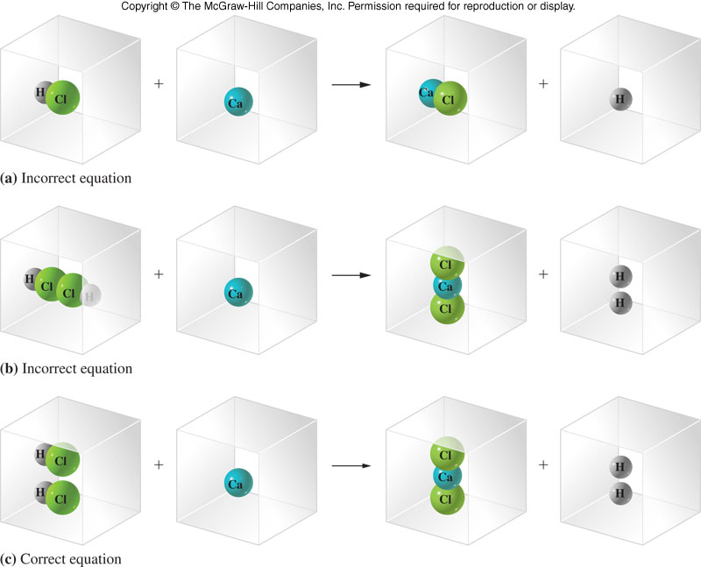
Balancing an equation
4.4 Balancing Chemical Equations

Slide 41
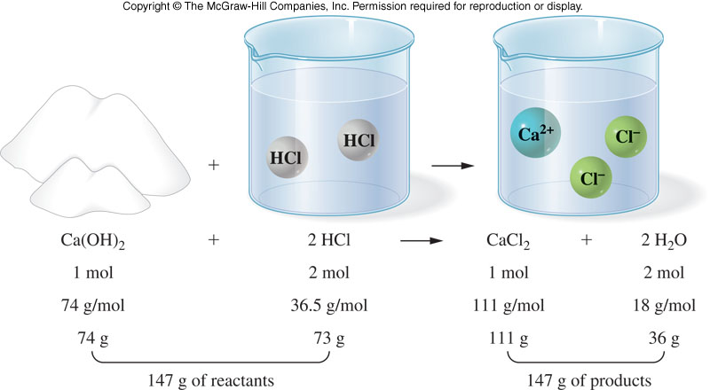
A visual example of the law of conservation of mass
4.5 Calculations Using the Chemical Equation

