Slide 1

Solutions
Lecture 8 for BES102 & BVW102
18 March 2009
Philip Button
Department of Agriculture and Animal Science
Northern Melbourne Institute of TAFE

Slide 2
Lecture 8 objectives
Understanding of:
  Features of solutions
  Solubility and saturation
  Calculations
    Percentage concentrations
    Molar concentrations
    Dilutions

Slide 3
6.1 Properties of solutions
Solution - homogeneous mixture
Solute - the substance in the mixture present in lesser quantity
Solvent - the substance present in the largest quantity
Aqueous solution - solution where the solvent is water
Solutions can be liquids as well as solids and gases

Slide 4
Examples of solutions
Air - oxygen and several trace gases are dissolved in the gaseous solvent, nitrogen
Alloys - brass and other homogeneous metal mixtures in the solid state
Focus on liquid solutions as many important chemical reactions take place in liquid solutions
6.1 Properties of Solutions

Slide 5
General properties of liquid solutions
Clear, transparent, no visible particles
May have color
Electrolytes are formed from solutes that are soluble ionic compounds
Nonelectrolytes do not dissociate
Volumes of solute and solvent are not additive
  1 L ethanol + 1 L water does not give 2 L of solution
6.1 Properties of Solutions

Slide 6
Solutions and colloids
Colloidal suspension - contains solute particles which are not uniformly distributed
  Due to larger size of particles (1nm - 200 nm)
  Appears identical to solution from the naked eye
  Smaller than 1 nm, have solution
  Larger than 1 nm, have a precipitate
6.1 Properties of Solutions

Slide 7
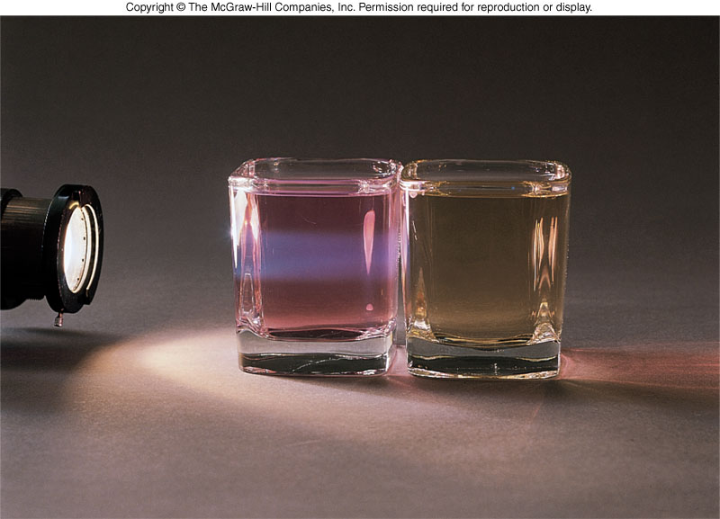
Tyndall effect
Tyndall effect - the ability of a colloidal suspension to scatter light
  See a haze when shining light through the mixture
  Solutions: light passes right through without scattering
6.1 Properties of Solutions
Colloidal suspension Solution
-light as haze, scatters light -no haze

Slide 8
Degree of solubility
Solubility - how much of a particular solute can dissolve in a certain solvent at a specified temperature
Factors which affect solubility:
  Polarity of solute and solvent
    The more different they are, the lower the solubility
  Temperature
    Increase in temperature usually increases solubility
  Pressure
    Usually has no effect
    If solubility is of gas in liquid, directly proportional to applied pressure
6.1 Properties of Solutions

Slide 9
Saturation
Saturated solution - a solution that contains all the solute that can be dissolved at a particular temperature
Supersaturated solution - contains more solute than can be dissolved at the current temperature
How is this done?
  Heat solvent, saturate it with solute then cool slowly
  Sometimes the excess will precipitate out
  If it doesn’t precipitate, the solution will be supersaturated
6.1 Properties of Solutions

Slide 10
6.2 Concentration based on mass
Concentration - amount of solute dissolved in a given amount of solution
Concentration of a solution has an effect on
  Physical properties
    Melting and boiling points
  Chemical properties
    Solution reactivity

Slide 11
Weight/Volume percent
Amount of solute = mass of solute in grams
Amount of solution = volume in milliliters
Express concentration as a percentage by multiplying ratio by 100% = weight/volume percent or % (W/V)
6.2 Concentration Based on Mass

Slide 12
Calculating Weight/Volume Percent
Calculate the percent composition or % (W/V) of 2.00 x 10² mL containing 20.0 g sodium chloride
  20.0 g NaCl, mass of solute
  2.00 x 10² mL, total volume of solution
% (W/V) = 20.0g NaCl / 2.00 x 10² mL x 100%
= 10.0% (W/V) sodium chloride
6.2 Concentration Based on Mass

Slide 13
Weight/Weight percent
Weight/weight percent is most useful for solutions of 2 solids whose masses are easily obtained
Calculate % (W/W) of platinum in gold ring with 14.00 g Au and 4.500 g Pt
  [4.500 g Pt / (4.500 g Pt + 14.00 g Au)] x 100%
  = 4.500 g / 18.50 g x 100% = 24.32% Pt
6.2 Concentration Based on Mass

Slide 14
Parts Per Thousand (ppt) and Parts Per Million (ppm)
As percentage is the number of parts of solute in 100 parts of solution, ppt and ppm change the calculation only by orders of magnitude
  ppt = g solute / g solution x 10³ ppt
  ppm = g solute / g solution x 10⁶ ppt
  ppt and ppm are most often used for very dilute solutions
6.2 Concentration Based on Mass

Slide 15
6.3 Concentration of solutions: moles and equivalents
Chemical equations represent the relative number of moles of reactants producing products
Many chemical reactions occur in solution where it is most useful to represent concentrations on a molar basis

Slide 16
Molarity
The most common mole-based concentration unit is molarity
Molarity
  Symbolised M
  Defined as the number of moles of solute per liter of solution
6.3 Moles and Equivalents

Slide 17
Calculating molarity from moles
Calculate the molarity of 2.0 L of solution containing 5.0 mol NaOH
Use the equation
Substitute into the equation:
M_{NaOH} = 5.0 mol solute
2.0 L solution
= 2.5 M
6.3 Moles and Equivalents

Slide 18
Calculating grams from molarity
6.3 Moles and Equivalents

Slide 19
Dilution
Dilution is required to prepare a less concentrated solution from a more concentrated one
  M₁ = molarity of solution before dilution
  M₂ = molarity of solution after dilution
  V₁ = volume of solution before dilution
  V₂ = volume of solution after dilution
6.3 Moles and Equivalents
moles solute = (M)(L solution)

Slide 20
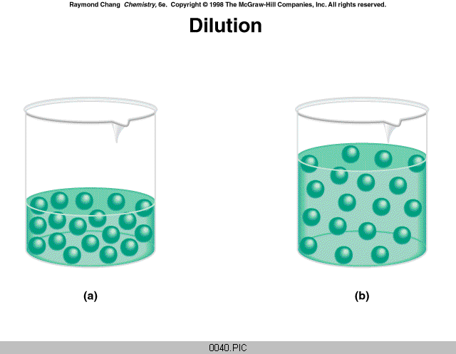
Dilution
In a dilution will the number of moles of solute change?
  No, only fewer per unit volume
So,
Knowing any three terms permits calculation of the fourth
M₁V₁ = M₂V₂
6.3 Moles and Equivalents

Slide 21
Calculating molarity after dilution
Calculate the molarity of a solution made by diluting 0.050 L of 0.10 M HCl solution to a volume of 1.0 L
  M₁ = 0.10 M molarity of solution before dilution
  M₂ = X M molarity of solution after dilution
  V₁ = 0.050 L volume of solution before dilution
  V₂ = 1.0 L volume of solution after dilution
Use dilution expression
X M = (0.10 M) (0.050 L) / (1.0 L)
  0.0050 M HCl OR 5.0 x 10⁻³ M HCl
6.3 Moles and Equivalents
M₁V₁ = M₂V₂

