Slide 1

Oxidation-reduction reactions
Lecture 9 for BES102 & BVW102
25 March 2009
Philip Button
Department of Agriculture and Animal Science
Northern Melbourne Institute of TAFE

Slide 2

Lecture 9 objectives
Understanding of:
  General significance of oxidation-reduction reactions
  Definition of an oxidation-reduction reaction
  The two half reactions that make up a complete oxidation-reduction reaction
  Examples of oxidation-reduction reactions

Slide 3
8.5 Oxidation-reduction processes
Extremely important reactions
Characterised by flow of electrons
All life depends on oxidation-reduction reactions for energy generation, for work
Oxidation - defined by one of the following
  loss of electrons
  loss of hydrogen atoms
  gain of oxygen atoms
Example: Na→Na⁺ + e⁻
  Oxidation half reaction

Slide 4
8.5 Oxidation-Reduction Processes
Reduction - defined by one of the following:
  gain of electrons
  gain of hydrogen
  loss of oxygen
Example: Cl + e⁻ → Cl⁻
  Reduction half reaction
Cannot have oxidation without reduction.
OIL RIG
  Oxidation Is Losing
  Reduction Is Gaining

Slide 5
Oxidation and reduction as complementary processes
Na → Na⁺ + e⁻
Cl + e⁻ → Cl⁻
Na + Cl →Na⁺ + Cl⁻
8.5 Oxidation-Reduction Processes
Oxidising Agent
Is reduced
Gains electrons
Causes oxidation
Reducing Agent
Is oxidized
Loses electrons
Causes reduction

Slide 6
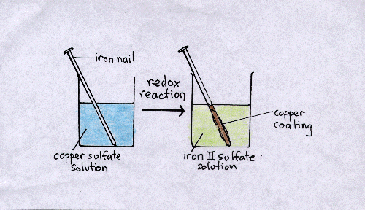
8.5 Oxidation-Reduction Processes
Oxidation half reaction
  Fe → Fe²⁺ + 2e⁻
Reduction half reaction
  Cu²⁺ + 2e⁻ → Cu
Full oxidation-reduction reaction
  2Fe + 3Cu²⁺ > 2Fe²⁺ + 3Cu

Slide 7
Biological processes
Respiration
  Electron-transport chain of aerobic respiration uses reversible oxidation and reduction of iron atoms in cytochrome c
Metabolism
  Break down of molecules into smaller pieces by enyzmes
8.5 Oxidation-Reduction Processes

Slide 8
Summary of glycolysis
glucose + 2ADP + 2P_{i} + 2NAD⁺
↓
2 pyruvate + 2ATP + 2NADH + 2H⁺

Slide 9
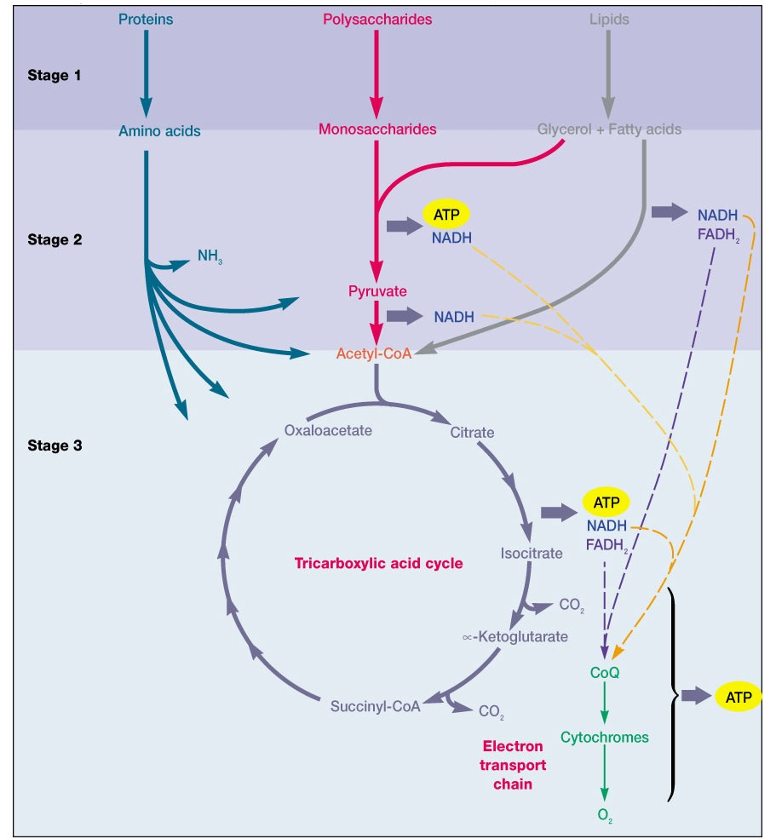
Aerobic respiration
8.5 Oxidation-Reduction Processes

Slide 10
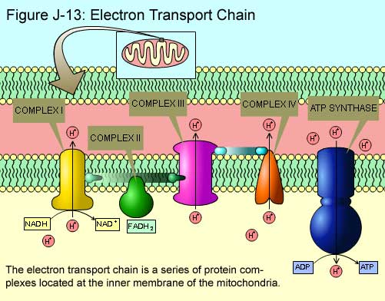
Electron transport chain
8.5 Oxidation-Reduction Processes

Slide 11
Applications of oxidation and reduction
Corrosion - the deterioration of metals caused by an oxidation-reduction process
  Example: rust (oxidation of iron)
  4Fe(s) + 3O₂(g) → 2Fe₂O₃(s)
Combustion of Fossil Fuels
  Example: natural gas furnaces
CH₄(g) + 2O₂(g) → CO₂(g) + 2H₂O(g)
8.5 Oxidation-Reduction Processes

Slide 12
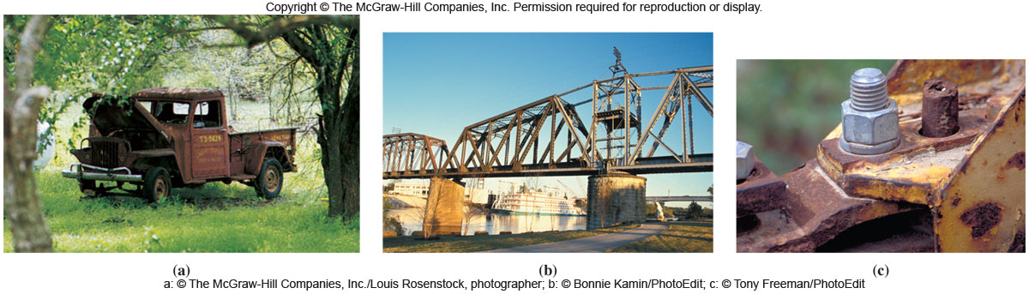
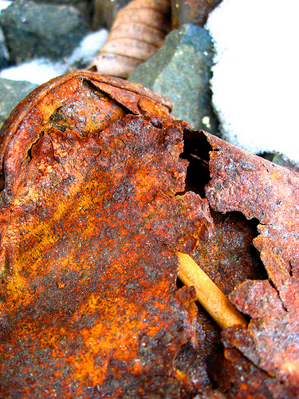
Metal corrosion
8.5 Oxidation-Reduction Processes
Oxidation of iron
  Iron loses electrons
  Fe → Fe²⁺ 2e⁻
Reduction of oxygen
  Oxygen gains electrons
  O₂ + 4e⁻ + 2H₂O → 4 OH⁻

Slide 13
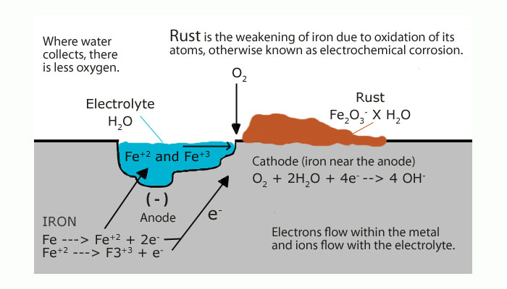
How iron(III) oxide forms in air
8.5 Oxidation-Reduction Processes

